Slide 1
Customer Prediction

Slide 2


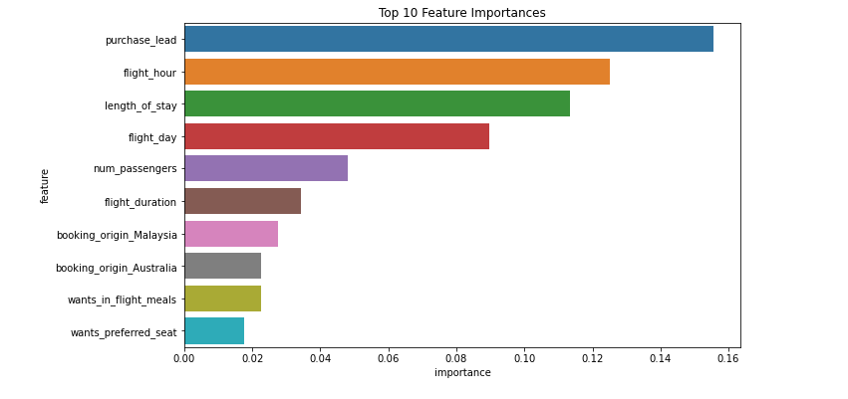
RESULTS
Model Performance:
🧠 Objective:
Build an interpretable machine learning model to predict whether a customer will make a booking.
🔍 Key Insights:
Model correctly predicts bookings/non-bookings 85.1% of the time overall. However, this is inflated by class imbalance (likely more non-bookings).
When the model predicts a customer will book, it's correct about 50.5% of the time.
Model only identifies 13.7% of actual bookings — it's missing many customers who do book. I suggest adding more customer-centric features to improve the model.
Most important predictive feature is “purchase_lead” which is the time between the purchase and departure.

